Slide 1
Chapter 1
Financial Statements and Financial Information
Notes:
Tutor guidance
Introduce the session and ensure students are aware of the correct chapter in their study material

Slide 2
Notes:
Tutor guidance
This slide provides a reference showing the type of content included in different slide types throughout the chapter.

Slide 3
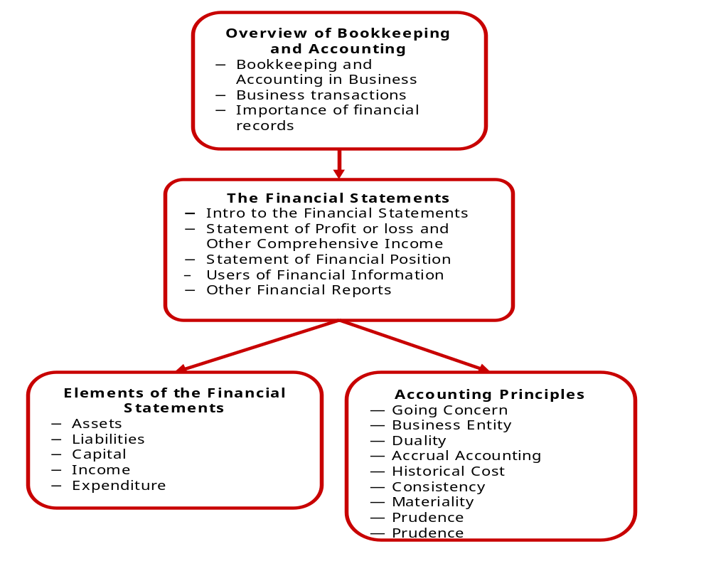
Chapter 1
Financial Statements and
Financial Information
Notes:
Tutor guidance
Briefly discuss this diagram with students, highlighting key sections.
Narrative
Before getting into the mechanics of recording transactions and bookkeeping, this chapter looks at what we are trying to achieve. Producing financial information.
We start off (top box) discussing the different business forms, and the purpose of accounting, before introducing the types of transaction that will be covered in this exam.
After this (second box) we will see what is included in a set of financial statements, and discuss the format of the statements as used in International Financial Reporting Standards (IFRS). The format of financial statements may be slightly different in your country – if that is the case, explain that F1 is based on IFRS accounting Standards.
The building blocks of a set of financial statements are referred to as the elements. (Lower left hand box). They are assets, liabilities, income and expenditure. Although you are probably aware of what these are, we will look at formal definitions as issued by the international accounting standards board, the body that issues IFRS.
Finally we will consider qualities of good financial information (bottom right hand box). These are the qualities that financial statements prepare in accordance with IFRS accounting standards aim to achieve.

Slide 4
Business and ownership
What is a business?
Sole trader
.
Capital
Owner
Business
Drawings
Notes:
Tutor guidance
Discuss with students the reason why businesses exist in the first place.
Provide some examples of businesses and why they ultimately exist. Talk about small owner managed businesses and large listed companies with thousands of shareholders. F1 will focus on small owner managed businesses.
Narrative
Why do businesses exist? (To make increase the wealth of the owners). Point out that some businesses may have additional purposes, such as a social purpose, like providing affordable food for low income families.
Businesses take many forms. The most basic type of business is a sole trader – where the founder of the business simply trades in their own name. There is no legal distinction between the owner, and the business.
The owner of the business is personally liable for the debts of the business
The assets of the business belong to the owner
However in accounting, we always treat the business as separate from the owner even if legally they are not separate.
There may be transactions between the owner and the business:
The owner pays capital into the business – for example to buy goods for resale, or to buy assets such as vehicles or furniture for the business.
The owner may withdraw money from the business, as the owner will need an income. These withdrawls are referred to as drawings.

Slide 5
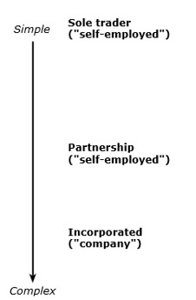

Business forms
.
Notes:
Tutor guidance
Cover this briefly as it is really just background information.
Narrative
We discussed sole traders in the previous slide. Larger businesses tend to take alternative forms.
Partnerships – are essentially a group of sole traders working together. They share resources and expertise. Historically they have been used by professional people – Doctors, Lawyers and accounts. They share the profits of the business. As with sole traders, there is no legal distinction between the partners and the business. However, many jurisdictions now offer limited liability partnerships, where the partners’ liability for the debts of the business is limited to their investment plus any other guarantees that they have given.
Incorporated businesses – often referred to as limited companies, are recognised as separate legal entities. The owners of the business own shares in the business, but do not own the assets as these are owned by the company. Similarly, they are not liable for the debts of the business. They receive dividends from the business in return for their investment (similar to drawings made by a sole trader). Incorporate entities usually have to file accounts with the registrar of companies, and there are other formalities associated with incorporation. Small companies may have only one or two shareholders. Some very large companies have thousands of shareholders, and their shares can be bought and sold on stock markets.

Slide 6
Activity 1
Make a list of all the businesses that you have had dealings with over the past week.
Which of these were likely to be sole traders?
Notes:
Tutor guidance
This is an easy activity which can be used as an ice-breaker. Consider getting students to work in pairs, discussing this.
Narrative
Spend three minutes thinking about this task. Write down the names of the business, and state what business form each of them takes, if you know.

Slide 7
Activity 1 - Solution
Small businesses can be set up as companies, but often for simplicity they are sole traders.
You may have other examples, but business that are likely to operate as sole traders include:
  Hairdressers, beauticians, etc
  Small, local shops e.g. newsagent, grocer, market stallholder
  Trades people, e.g. painter/decorator, cleaners
  Freelancers e.g. bookkeepers.
Notes:
Tutor guidance
This is an easy activity which can be used as an ice-breaker. Consider getting students to work in pairs, discussing this.
Narrative
Spend three minutes thinking about this task. Write down the names of the business, and state what business form each of them takes, if you know.

Slide 8
Definitions
Bookkeeping is the act of recording financial transactions and summarising those transactions
Accounting is the preparation of financial information into financial statements, based on the data prepared by the bookkeeper.
Notes:
Tutor guidance
Work through the definitions.
Narrative
Bookkeeping is the initial recording of transactions as they come in. The transactions are categorised (e.g. into different cost categories, or assets and liabilities) and posted to accounts. Most of the syllabus of F1 is about bookkeeping.
The totals in the accounts are used to produce the financial statements and other reports for the various stakeholders of the business. Internal accounts (often referred to as management accounts) are also prepared to enable the managers to monitor the performance of the business.

Slide 9
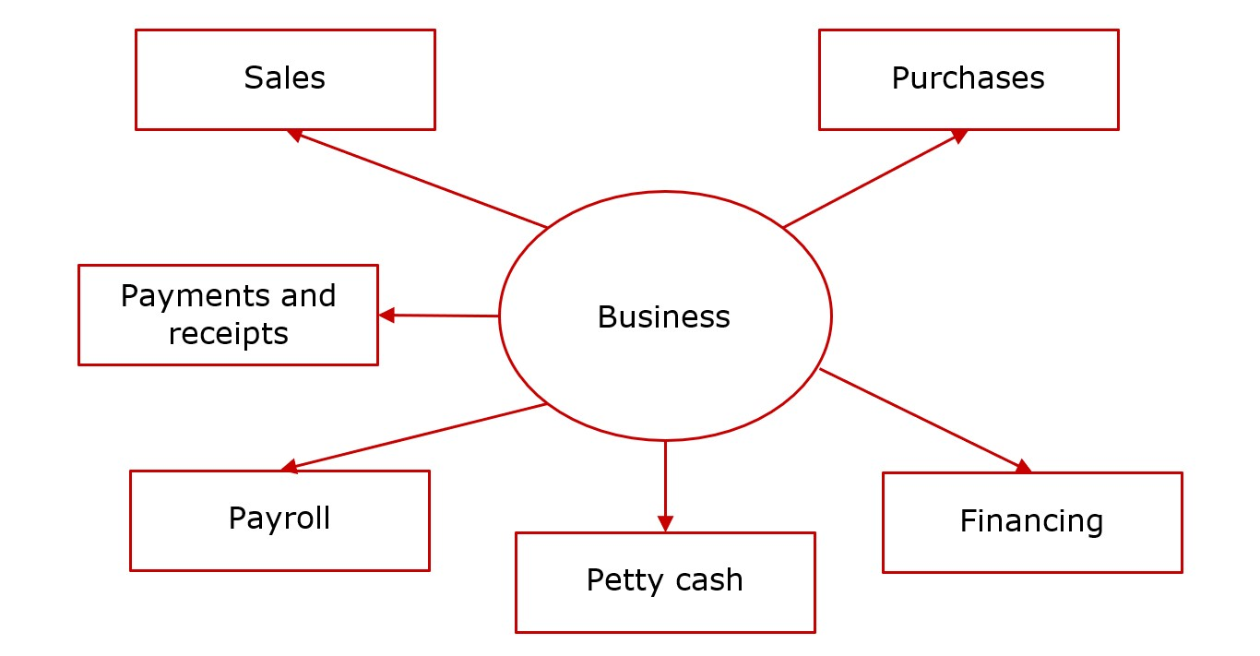
Types of business transactions
.
Notes:
Tutor guidance
F1 is about recording transactions, so it is important to know from the outset what the main types of business transactions.
Perhaps use the example of a simple business such as a small shop to illustrate the transactions.
Narrative
Sales - exchanging goods or services for money. Sales revenue has to be sufficient to cover all of the costs of the businesses.
Purchases – buying goods or services that the business needs to operate
Payments & receipts – receiving money, usually from customers, and paying money, usually to suppliers. Other types of receipt and payment also occur.
Payroll – involves calculating the wages and salaries of employees, making deductions for tax and similar items, and paying the employees.
Petty cash payments – paying for low-value items using a small fund of cash
Financing - involve raising the funds that the business needs for investment purposes. In F1 this is mainly paying of capital into the business and drawings being taken out by the sole trader.

Slide 10

Importance of Maintaining Financial Records
Financial information is of importance and use to those both within the business and those external to it.
Internal Users of Financial Information:
  Owners
  Employees
Notes:
Tutor guidance
Talk about how internal users, (owners and employees), use financial information. Use the narrative below if it is helpful or add your own explanations.
Narrative
Business Planning by Owners
Business planning is an internal reason for maintaining records. It involves the business owner looking ahead and creating a plan for the future of the business. To make business decisions, owners must have financial records ready to be analysed to produce an action plan.
Employees of the Business
Employees are internal users of financial information as they require information regarding individual transactions to operate in their respective functions.

Slide 11

External Users of Financial Information
External users include:
  Tax Authorities
  Regulatory Bodies
  Business Lenders
  Suppliers
  Investors
  Customers and the public
Notes:
Tutor guidance
Briefly discuss the users and their information needs. Consider quizzing the students on what information they think each user needs to make the discussion more interactive.
Narrative
Tax Authorities
Sole Traders are required to maintain financial records mainly for tax purposes. They need to report their taxable profits to the tax authorities and pay tax on these. Tax authorities may request further information and documents to verify the authenticity of figures in the financial statements.
Regulatory Bodies
The business’s local legislative bodies set the rules and regulations governing the preparation of financial statements. Different governments may have specific rules for preparing and keeping financial records.
Business Lenders
Lenders like banks and other borrowers will need evidence of the business's ability to repay its debt.
Suppliers
Like lenders, suppliers may need information regarding the business’s financial stability before offering to sell goods on credit, determining the credit term and the maximum purchases the business can make.
Investors
Existing investors of a business will want to know its financial position to determine if it is making profits and keeping a healthy financial position.
Customers and the Public Financial information will interest business customers as they want to know if their supply of goods is secure. This is especially important where a customer can only purchase from a limited number of suppliers.

Slide 12
Document Retention
Document retention is keeping paper or digital documents and business information for a specific period.
A document retention policy manages documents and records from creation to destruction.
Notes:
Tutor guidance
Explain the importance of keeping all accounting documentation, records, etc and that all countries will have their only retention period in addition to the requirements of individual businesses e.g. customer database.

Slide 13
Document Retention
Business documents are kept for a specific number of periods to:
Comply with legislation.
  Each country has legislation that requires a business to keep financial documents for a specific period.
  Data protection laws limits the amount of time that a business can keep personal information.
Retrieve historical documents.
  Information from the past can be referred to, such as emails containing critical information.
  Some information is required permanently. Such information is stored as ‘Master Files’.
Notes:
Tutor guidance
Explain the importance of keeping all accounting documentation, records, etc and that all countries will have their only retention period in addition to the requirements of individual businesses e.g. customer database.

Slide 14
Activity 2
For each of the four purposes of financial information below, select the relevant user from the list on the right.
1. To monitor the performance of the business and make decisions about its activities
2. To ensure that the business has sufficient profits to repay interest on loans
3. To ensure that the information in tax returns is accurate
4. To ensure that the business has the ability to continue trading in the long term, and ensure the availability of goods and services
Bank manager
Tax authorities
Customers
Owners
Notes:
Tutor guidance
Use this activity to demonstrate how different users have different requirements from the financial statements.

Slide 15
Activity 2 - Solution
1. To monitor the performance of the business and make decisions about its activities - OWNERS
2. To ensure that the business has sufficient profits to repay interest on loans – BANK MANAGER
3. To ensure that the information in tax returns is accurate – TAX AUTHORITIES
4. To ensure that the business has the ability to continue trading in the long term, and ensure the availability of goods and services - CUSTOMERS
Notes:
Tutor guidance
Do ensure that your students are able to demonstrate how different users have different requirements from the financial statements, and the reasons for this.

Slide 16
Financial statements
The principal financial statements are:
Statement of Profit or Loss and Other Comprehensive Income (SPLOCI)
Statement of Financial Position (SFP)
Statement of Cash Flows (SCF)
Statement of Changes in Equity (SOCIE)
Notes:
Tutor guidance
Briefly mention the purpose of the main two financial statements:
Statement of Profit or Loss and Other comprehensive income is a high-level summary of the business’s activities during the year. Shows revenues, costs (categorised appropriately) and profit or loss. The
The Statement of Financial Position highlights the current position of the business's assets, liabilities and capital at a particular date.
The Statement of Cash Flows, is not examined in F1. Students will only need to know how to prepare an SFP and SPL for a sole trader for F1.

Slide 17
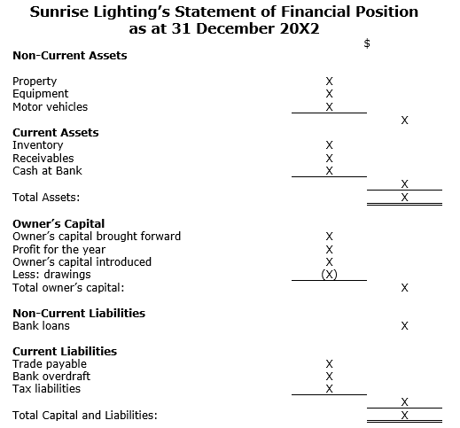
Example 1
SFP for a sole trader.
It uses the accounting equation:
ASSETS =
LIABILITIES +
CAPITAL
Notes:
Tutor Guidance
Go through the structure of the Statement of Financial Position
Narrative
Title – The statement of financial position shows the closing position of Sunrise Lighting’s assets, liabilities and capital balance at their financial year-end of 31 December 20X2.
Non-current assets – These are assets owned by Sunrise Lighting to be used to generate profits over a period of more than 12 months.
Current assets – These assets can be converted into cash or consumed by the business within the next 12 months.
Owner’s capital – is the owner's interest in the business. It comprises the cash invested into the business by the owner, any profits (or loss) generated by the business minus any amounts the owner has withdrawn from the business as drawings.
Owner’s capital brought forward – is the value of capital at the start of the year (the opening capital). In this SFP, the start of the year is 1 January 20X2.
Profit for the year – is the profit reported in the statement of profit or loss.
Owner’s capital introduced – is cash invested into a business by its owner.
Drawings –cash or assets withdrawn from a business by the owner for personal use.
Non-current liabilities – These are liabilities of Sunrise Lighting that will be settled (paid) in more than 12 months.
Current liabilities – These liabilities will be settled (paid) within 12 months.
The Total asset amount should equal the Total capital and liabilities amount.

Slide 18

The Accounting Equation
.
Key point
ASSETS = LIABILITIES + CAPITAL
Notes:
Tutor guidance
Introduce the concept of the accounting equation to the students. This is a good source of exam questions
Narrative
The basic accounting statement is shown in the slide:
Amount a business owns (Assets) - Amount a business owes (Liabilities) = Amount owed to the owners (Capital)
An alternative way of looking at this is to think about how a business gets funds to buy its assets. It either borrows the funds (liabilities) or the owners invest their funds into the business (Capital).
If transactions have been recorded correctly, the accounting equation will always balance.

Slide 19
Example 2
Sunrise Lighting - Statement of Profit or Loss for the year ended 31 December 20X2
 | $ | $
Sales |  | X
Less: Sales Returns |  | (X)
 |  | X
Cost of Goods Sold
Opening Inventory | X
Purchases | X
Carriage Inwards | X
Less: Purchase Returns | (X)
 | X
Less: Closing Inventory | (X)
 |  | (X)
Gross Profit: |  | X
Operating Expenses
Carriage Outwards | X
Electricity | X
Rental | X
Repairs | X
Sundry Expenses | X | (X)
Operating Profit |  | X
Interest expenses |  | (X)
Profit |  | X
SPL for a sole trader:
Sales
Less: COGS
= Gross profit
Less Operating expenses
= Profit
Notes:
Tutor Guidance
Go through the structure of the Statement of Profit and Loss
Narrative
Title – The Statement of profit or loss reports the income and expenses for Sunrise Lighting's accounting period of 1 January 20X2 to 31 December 20X2.
Sales – The income generated by Sunrise Lighting‘s normal trading activities. In the case of Sunrise Lighting, it is the selling of light fittings and lamps.
Cost of Goods Sold – This is the cost of goods purchased by Sunrise Lighting and sold during the year.
Gross Profit –the difference between Sunrise Lighting’s sales and the cost of goods sold.
Operating Expenses – These are costs incurred in the day-to-day running of the business.
Interest Expenses – A business may incur interest charges on bank overdrafts, loans, or external borrowings.
Profit – is the excess of income after all business expenses have been paid. The Profit amount is transferred to the 'Profit for the Year' section of the Statement of Financial Position, thus increasing capital.

Slide 20
Income and expenses
.
Income is a business’s received economic benefit in cash or assets from sales (revenue) or other sources.
  Income is increases in assets, or decreases in liabilities, that result in an increase in equity, other than those relating to contributions from holders of equity claims.
Expenses are decreases in assets, or increases in liabilities, that result in decreases in equity, other than those relating to holders of equity claims.
  An expense is the day-to-day running costs incurred by the business.
Notes:
Tutor guidance
Income
Sunrise Lighting is a business that sells light fittings and lamps. Income derived from its normal trading activities (selling light fittings and lamps) is categorised as sales.
Other income of Sunrise Lighting could be rental income (from space the business does not use) or interest received on bank deposits.
An expense is the day-to-day running cost incurred by the business.
Expenses can include electricity, rent, salaries, and interest paid. Expenses are reflected in the Statement of Profit or Loss.

Slide 21
Elements of the Financial Statements
An asset is a present economic resource controlled by the entity as a result of past events. An economic resource is a right that has the potential to produce economic benefits.
A liability is a present obligation of the entity to transfer an economic resource as a result of past events.
Capital is the net assets of the business.
          Capital = Assets - Liabilities
.
Notes:
Tutor guidance
While these definitions are a little dry, try to liven up the discussion by quizzing the students on things that may or may not meet the definitions.
Narrative
These definitions come from the IFRS Conceptual Framework, which sets of the elements of financial statements.
While most people would be able to identify an asset or a liability there are situations when it might not be certain whether something is one of these, which is why definitions are needed.
Starting with asset: An economic resource is a right that has the potential to produce economic benefits – such as generating sales or income. In order to qualify as an asset, the economic resource must be controlled by the entity. It is not necessary for the business to own the asset legally – so for example, an asset that is leased may be controlled by the entity, but may be legally owned by the lessor.
Can you think of other example of assets? Why are they assets?
Liabilities: A present obligation – means that the entity has no practical ability to avoid the liability. It may be legal, but does not have to be. For example, a promise to give all staff a bonus might not be legally binding, but if the business does not honour this, staff may take industrial action. The obligation has to be a result of past events – so liabilities relating to future decisions (e.g. fines that may be incurred due to future actions) would not be recognised as a liability, since there is no present obligation.
Capital is the difference between the assets and liabilities

Slide 22
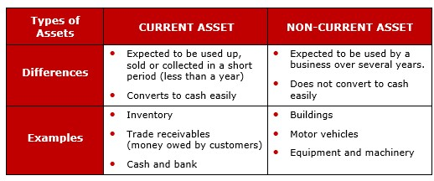
Current vs Non-Current Assets
.
Notes:
Tutor guidance
Explain the difference between current and non-current assets, using the slide to give structure to your discussion.
Narrative
A current asset is any asset that is expected to be converted into cash, sold, or consumed within one year or within the company's normal operating cycle, whichever is longer. The most common ones are inventory, trade receivables and cash.
A non-current asset is an asset that is expected to be used by the business over more than one year.

Slide 23
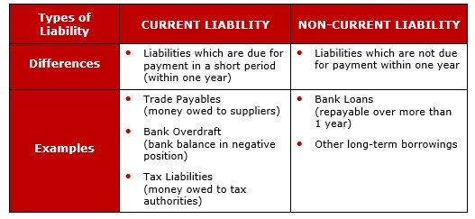
Current Liabilities and Non-Current Liabilities
.
Notes:
Tutor guidance
Explain the difference between current and non-current liabilities, using the slide to give structure to your discussion.
Narrative
A current liability is essentially a liability that will be settled within one year. It is usually part of the operating cycle – for example, trade payables are where goods are acquired from suppliers on credit but must be paid within a relatively short period of time (one or two months).
A non-current liability is a liability that will be settled by more than one year. Examples include bank loans where the date for repayment is more than twelve months from the reporting date.

Slide 24
Activity 3
0
Decide whether the following assets owned by RFashion (a clothing retail company) are current or non-current:
a) Cash
b) Delivery vehicle
c) Money in the bank account
d) Factory equipment
Notes:
Tutor guidance
An opportunity for students to demonstrate their understanding of the difference between current and non-current assets.

Slide 25
Activity 3 - Solution
a) Cash: Current Asset
b) Delivery vehicle: Non-Current Asset
c) Money in bank account: Current Asset
d) Factory equipment: Non-Current Asset
Notes:
Tutor guidance
If students struggle to demonstrate their understanding of the difference between current and non-current assets, give them some further examples.

Slide 26
The sources of finance include:
Capital from Owners
Bank Overdraft
Bank Loans
Leases
Borrowings
Financial statements are usually made available to external providers of finance to assist their decision of whether to lend.
0
Notes:
Tutor guidance
Elaborate that all businesses need financing to operate. This financing comes from investments (capital from equity investors) or debts (bank loans).
Narrative
Unlike other types of finance, capital from owners has no fixed repayment date and does not incur interest costs, unlike a bank loan.
Banks may offer a business an overdraft facility with a fixed limit, which is usually reviewed annually. A bank overdraft is an expensive form of finance as it carries a higher interest rate than other longer-term finance options, such as bank loans.
A bank account in an overdraft position is classified as a liability.
A bank may issue a loan with a fixed repayment date and pre-determined interest rate, usually lower than an overdraft.
The bank authorises a bank loan after looking into the business's financial credibility. They may also require the business to put up its assets as security if it defaults on a loan.
Bank loans provided to a business are classified as liabilities.
A business may purchase assets by leasing instead of paying in full. A lease is a contractual arrangement between two parties to use an asset in exchange for periodic payments.
When a business leases an asset, it will pay regular instalments to the other party in exchange for being able to use the asset. The business does not legally own the asset.
Borrowings
A business may borrow money from outside the business, such as from family members or friends. The arrangements for the loan in terms of the repayment date or interest rates are agreed upon between the lender and the borrower.
Like bank loans, amounts borrowed are classified as liabilities.

Slide 27
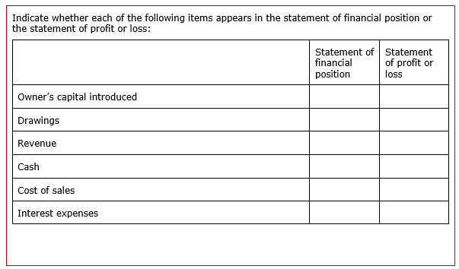
Activity 4
.
Notes:
Tutor guidance
An opportunity for students to demonstrate their understanding of the difference between SFP and SPL and their elements.

Slide 28
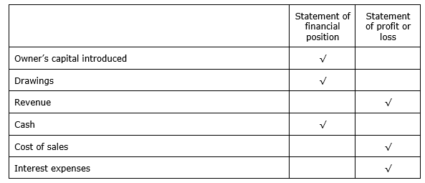
Activity 4 - Solution
00
Notes:
Tutor guidance
If students struggles to demonstrate their understanding of the difference between SFP and SPL and their elements, give them some further examples.

Slide 29
Accounting Principles
Key principles underlying financial statements:
Going Concern
Business Entity
Duality
Accrual Accounting
Historical Cost
Consistency
Materiality
Prudence
Notes:
Tutor guidance
Going concern:
Financial statements assume the business will continue operational existence for the foreseeable future and has neither the intention nor the need to enter liquidation or cease trading.
The business entity concept states that the owner and the business are separate entities (even though they may be the same legally).
The owner and the business may have transactions between them (for example, capital introduced and drawings). Ultimately, all information in the financial statements relates only to the business, not the owner
The duality concept also known as the dual effect or dual aspect or the double entry concept explains that every transaction has two impacts on a business.
For example, if a business buys a van for cash, this impacts the cash account and the motor vehicle account. Cash has decreased while a new asset (the van) is introduced to the business.
Accrual accounting is also known as the matching concept. Accrual accounting means that all income and expenses incurred should be recognised in the period to which they relate. The impact of income and expense transactions is recognised when they occur, not on whether cash has been received or paid.
The historical cost concept states that all transactions are initially recorded at historical cost, which is the cost at the time of the transaction. The historical cost system of accounting is particularly relevant to assets.
The consistency concept requires that all similar transactions apply a consistent accounting treatment from one accounting period to the next. This allows for a better comparison of financial statements between different years and transactions of the same nature.
For example, the same depreciation method should apply to all motor vehicles. For similar types of inventories, a consistent method of valuation is used.
Materiality Financial information is material if its omission can affect the decisions made by users of that information, and so should be accurately included in the financial statements.
The prudence concept ensures that caution is exercised when making judgements about events that may be uncertain. The prudence concept means that assets and income are not overstated, while liabilities and expenses are not understated.

Slide 30
Activity
.
Chapter Quiz
Chapter 1 Financial Statements and Financial Information
Question 1 to 5
Notes:
Tutor guidance
Ask your students to attempt Chapter Quiz, Chapter 1 Financial Statements and Financial Information - All Qs.

Slide 31
Chapter summary
A business is an organisation that aims to make a profit for its owner(s).
Businesses take many forms, including owner-managed sole traders, partnerships, and incorporated entities (companies).
Sole traders are personally responsible for the liabilities of the business, while the owners of incorporated entities are not.
Bookkeeping is the act of recording financial transactions.
Accounting is the use of the information compiled by the bookkeeper to prepare the Financial Statements of an organisation, which are used for many reasons e.g. decision-making, planning, sourcing finance, taxation.
.
Notes:
Tutor guidance
An opportunity to sum up the main points of this session – do add your own thoughts and ask students what they have learnt and where they feel less confident.

Slide 32
Chapter summary (2)
.
Types of Financial Transactions
Sales
Purchases
Payments
Receipts
Petty Cash Payments
Payroll Payments
Financing transactions

Slide 33
Chapter summary (3)
Financial records and information are maintained by a business to satisfy users of financial information.
Users, both internal and external, are parties interested in the financial affairs of the business.
Document retention is keeping paper or digital documents and business information for a specific period.
A document retention policy manages documents and records from creation to destruction.

Slide 34
Chapter summary (4)
The principal financial statements are:
  Statement of financial position (SFP)
  Statement of profit or loss and other comprehensive income (SPLOCI)
  Statement of cash flows (SCF)
  Statement of changes in equity (SOCIE)
The statement of profit or loss shows the performance of a business, detailing the sales and expenses over a particular period (usually 12 months).

Slide 35
Chapter summary (5)
The statement of financial position shows the assets, liabilities and capital of a business on a specified date (the year-end).
An asset is a present economic resource controlled by the entity as a result of past events. An economic resource is a right that has the potential to produce economic benefits.
A liability is a present obligation of the entity to transfer an economic resource as a result of past events.
Capital is the net assets of a business. Net assets are the difference between assets and liabilities.
.

Slide 36
Chapter summary (6)
Income is increases in assets, or decreases in liabilities, that result in an increase in equity, other than those relating to contributions from holders of equity claims.
Expenses are decreases in assets, or increases in liabilities, that result in decreases in equity, other than those relating to holders of equity claims.
.

Slide 37
Chapter summary (7)
The Key Principles in Accounting are:
  Going Concern
  Business Entity
  Duality
  Accrual Accounting
  Historical Cost
  Consistency
  Materiality
  Prudence
.

